Slide 1

The Future of Liver Surgery in Kenya
Dr. Ondede Kenedy
Consultant Hepatobiliary Surgeon, Kenyatta National Hospital
Gastrosociety of Kenya • November 12th , 2025

Slide 2
Declarations
No Conflict of Interest
No Financial Sponsorship
This presentation contains no commercial bias or conflicts that could influence clinical recommendations or decision-making.
No pharmaceutical companies, medical device manufacturers, or other commercial entities provided funding or support for this presentation.
All content represents independent clinical expertise and evidence-based practice recommendations for hepatobiliary surgery in the Kenyan context.

Slide 3
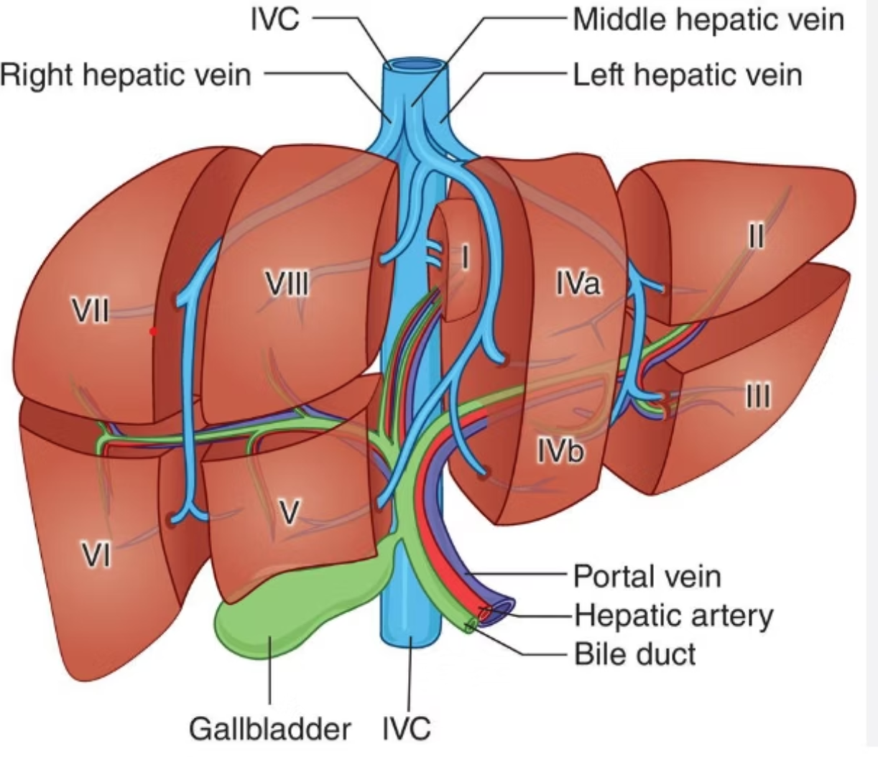
Segmental Anatomy of the Liver
Understanding hepatic segmental anatomy is fundamental to modern liver surgery. The Couinaud classification divides the liver into eight functionally independent segments, each with its own vascular inflow, outflow, and biliary drainage.
Clinical Significance:
Enables precise anatomical resection planning
Minimizes blood loss during surgery
Allows preservation of maximal functional liver tissue
Critical for transplant donor hepatectomy
Mastery of segmental anatomy distinguishes modern hepatobiliary surgery from historical approaches and forms the foundation for advanced surgical techniques.

Slide 4

The Future: Technological Advancement in Liver Surgery
Minimally Invasive & Robotic Surgery
Artificial Intelligence Integration
Advanced Imaging Technologies
3D visualization with enhanced clarity achieves better tumor-free margins (R0 resection). Increased dexterity allows precise dissection in complex anatomical spaces with reduced blood loss and faster patient recovery.
AI-powered surgical planning through 3D modeling, printing, and virtual reality enables surgeons to rehearse complex procedures, visualize tumor relationships, and optimize resection strategies before entering the operating room.
Near-infrared imaging provides real-time visualization of biliary anatomy and tumor margins. Histotripsy uses focused ultrasound for non-invasive tissue ablation, offering new treatment options for unresectable tumors.
Reference: Huettl F, Saalfeld P, Hansen C, et al. Ann Transl Med 2021;9:1074

Slide 5




Diagnostic Pathways in Liver Disease
Advanced Radiology
Tumor Markers
Dynamic contrast-enhanced CT and MRI with hepatobiliary-specific contrast agents provide comprehensive characterization of liver lesions with high sensitivity and specificity.
Serum biomarkers including AFP, CEA, and CA 19-9 guide diagnosis and surveillance. Elevated AFP strongly suggests HCC in cirrhotic patients with characteristic imaging findings.
Tissue Biopsy
Percutaneous or surgical biopsy provides definitive histological diagnosis when imaging is inconclusive or molecular profiling is needed to guide targeted therapy decisions.

Slide 6
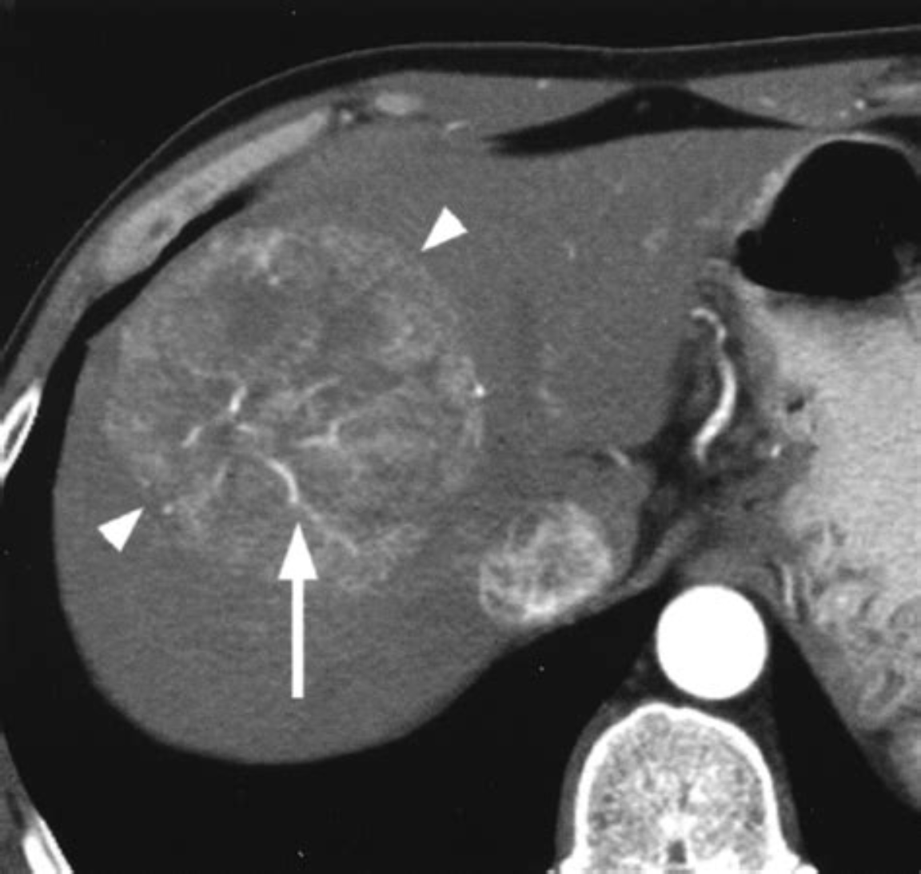
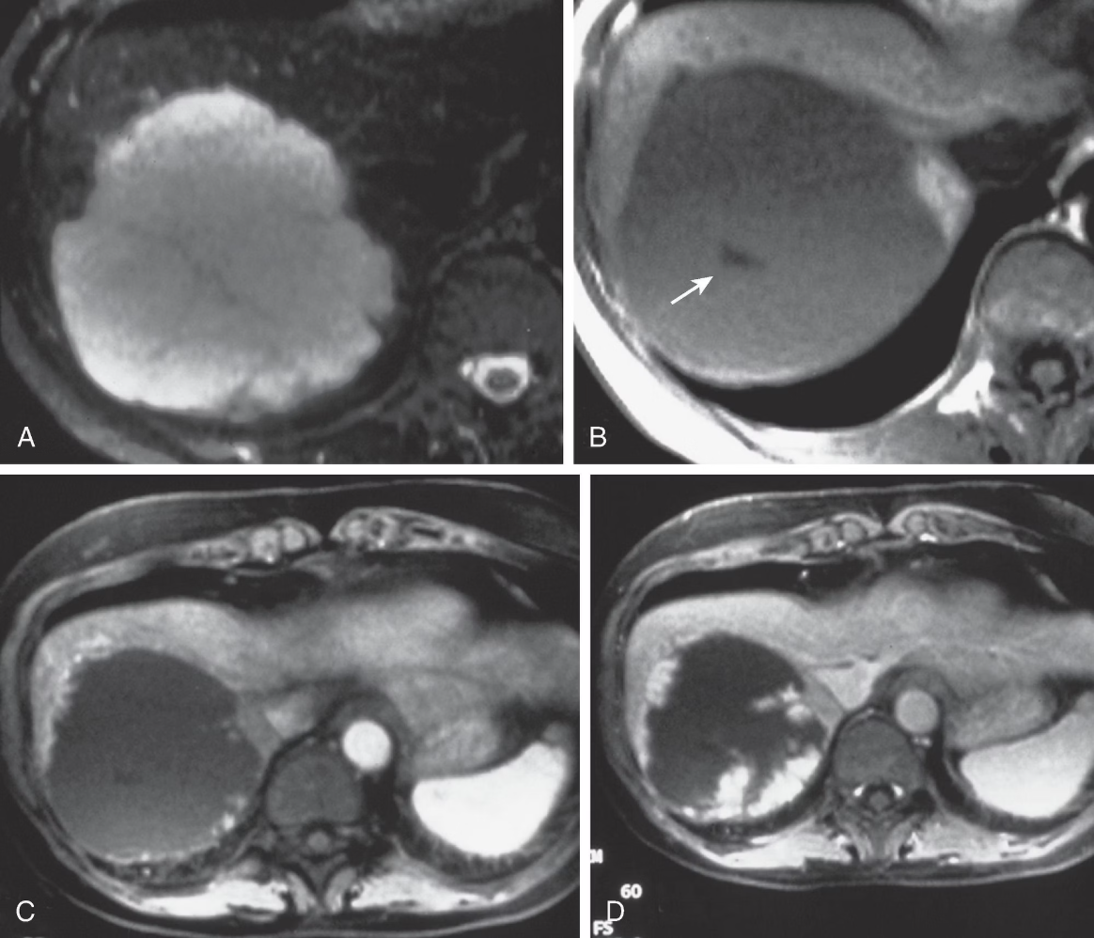
Classical Radiological Features of Common Liver Lesions
Hepatocellular Carcinoma (HCC)
Hemangiomas
Classic appearance: Hypodense lesion on non-contrast imaging showing peripheral nodular enhancement with progressive centripetal fill-in on delayed phases.
Diagnostic hallmark: Arterial hyperenhancement followed by venous or delayed phase washout on dynamic CT or MRI.
This characteristic pattern in cirrhotic patients with lesions >1cm is sufficient for diagnosis without biopsy in most cases.
Benign vascular tumors requiring differentiation from malignancy through characteristic enhancement patterns.

Slide 7

Liver Biopsy: Evidence-Based Indications
Guidelines Recommend MDT Approach
1
Both the European Association for the Study of the Liver (EASL) and the American Association for the Study of Liver Diseases (AASLD) recommend an individualized multidisciplinary team approach to liver biopsy decisions.
2
Non-Invasive Radiology Often Sufficient
High-quality dynamic imaging typically provides adequate diagnostic information, particularly for classic presentations of HCC and benign lesions like hemangiomas.
Specific Biopsy Indications
3
Biopsy is indicated when radiology is inconclusive, in non-cirrhotic patients, for metastases of unknown origin, for molecular profiling in unresectable masses, or when tissue diagnosis is essential to guide treatment decisions.
4
Reference: EASL Clinical Practice Guidelines: Management of hepatocellular carcinoma. J Hepatol. 2018;69:182-236.

Slide 8
When to Avoid Liver Biopsy
Classic Imaging Features Present
Curative Treatment Planned
Chronic liver disease or cirrhotic patients with lesions >1cm displaying hallmark HCC features on CT/MRI do not require tissue confirmation. Biopsy adds risk without diagnostic benefit.
When liver transplantation, hepatectomy, or ablation is planned, surgical pathology will provide definitive diagnosis. Pre-operative biopsy risks tumor seeding along the needle tract.
Small Lesions in Low-Risk Patients
Characteristic Hemangiomas
Lesions <1cm in patients without cirrhosis or risk factors can be monitored with serial imaging rather than immediate biopsy, avoiding complications in likely benign lesions.
Lesions with pathognomonic hemangioma features on imaging require no further investigation. Biopsy is unnecessary and carries bleeding risk in these vascular tumors.

Slide 9






Advanced Interventions
Cholangioscopy & ERCP
RFA & Microwave Ablation
Direct visualization of bile ducts for diagnosis and therapeutic intervention in complex biliary pathology.
Minimally invasive tumor destruction for patients unsuitable for resection or as bridge to transplant.
ALPPS/Portal Vein Embolization/TACE
ICG Fluorescence & Volume Assessment
Inducing rapid hypertrophy of future liver remnant to enable extended resections in previously inoperable cases.
Real-time liver function assessment and remnant volume calculation using Memphis app and ICG clearance.
CUSA Technology
Liver Transplantation
Cavitational ultrasonic surgical aspirator enables precise parenchymal transection with vascular preservation.
Definitive treatment for end-stage liver disease and selected malignancies within Milan criteria.

Slide 10
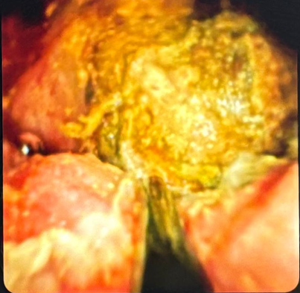
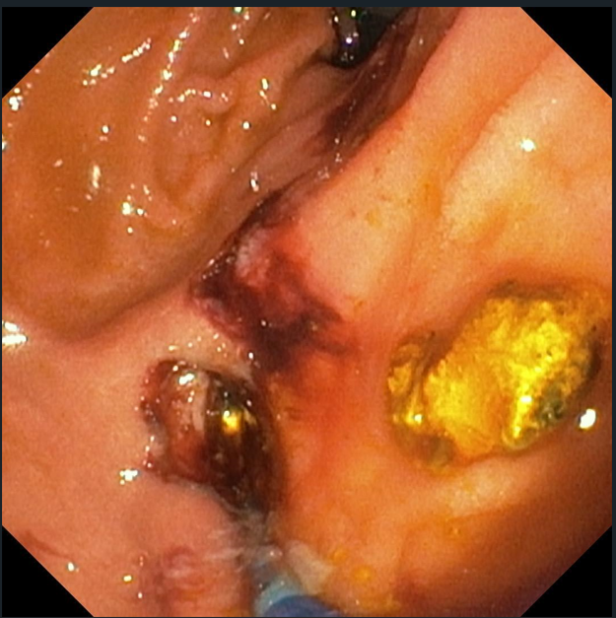
Hilar cholangiocarcinoma
Impacted CBD stone

Slide 11
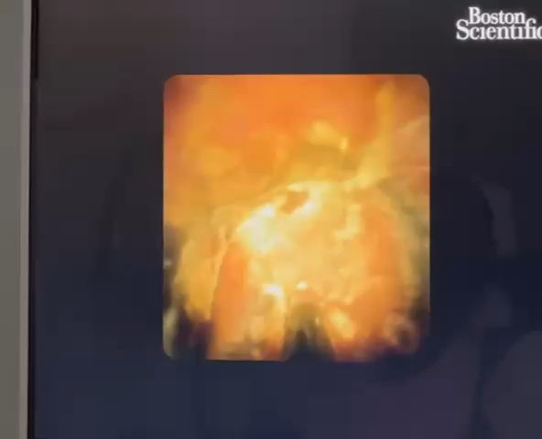

Slide 12
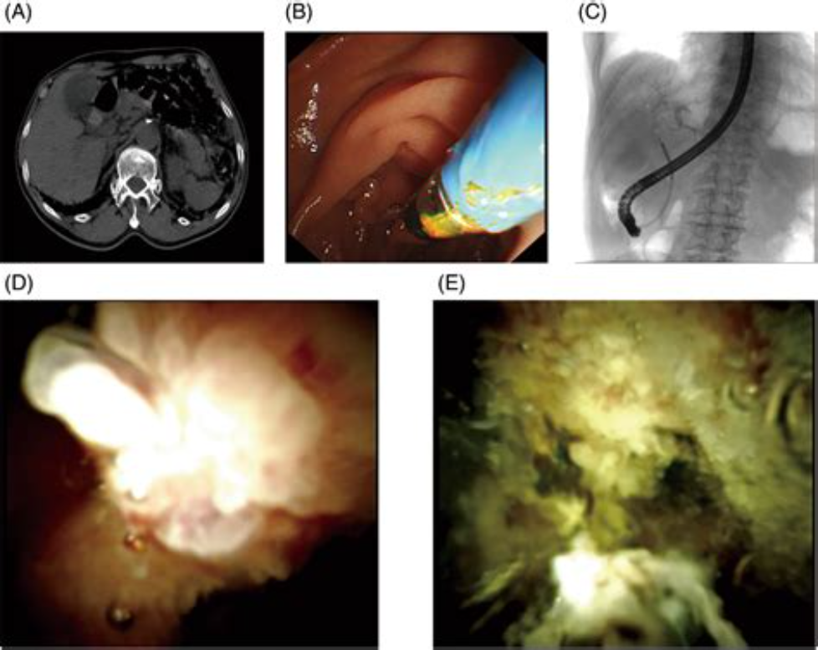

Cholangioscopy: Clinical Applications
Direct cholangioscopy provides transformative diagnostic and therapeutic capabilities for complex hepatobiliary pathology that extends beyond conventional ERCP.
Indeterminate Biliary Strictures
Direct visualization with targeted biopsies distinguishes benign from malignant strictures when imaging and brush cytology are inconclusive.
Complex Stone Management
Enables treatment of difficult bile duct stones resistant to conventional extraction through direct visualization and lithotripsy.
Tumor Staging & Extent
Assesses longitudinal tumor spread in cholangiocarcinoma, guiding surgical planning and resectability decisions.
Therapeutic Guidance
Directs ablative therapies including radiofrequency ablation for intraductal tumors under direct visualization.

Slide 13


